Slide 1
3D Basic & OpenGLES 2.0
thuy.vuthiminh@gameloft.com
phong.caothai@gameloft.com
khiem.tranthien@gameloft.com
tam.la@gameloft.com

Slide 2


Content
Introduction
Rendering pipeline
Basic knowledge in Opengles 2.0?
Shader
Basic GLSL-ES
Basic Math
MVP matrices
Textures
Model
Shader effect: Skydome using cube mapping

Slide 3
Content
Introduction
Rendering pipeline
Shader
Basic GLSL-ES
Basic Math
MVP matrices
Textures
Model
Shader effect: Skydome using cube mapping

Slide 4
Introduction
3D Coordinates
Vertex
Edge
Triangle & Quad
Normal vector
Pixel
Texel
Fragment
Parallel & perspective projections
Bonus: Color channel
3D Basic concept?

Slide 5
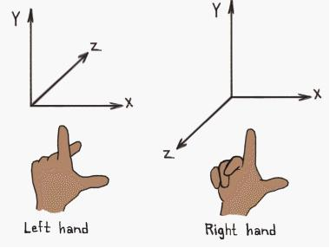
Introduction: 3D Coordinates
The right handed coordinate system is used by OpenGL
The left handed coordinate system is used by DirectX

Slide 6
Introduction: 3D Coordinates
-1, 1, 1
1, 1, 1
The OpenGL Coordinate System
3D point in clip coordinates is mapped to a cube (NDC) (Normal Device Coordination)
NDC uses left-handed coordinate system
In the bounds of [-1,-1,-1] and [1, 1, 1]
Everything outside that bound will not be taken into consideration.
-1, 1, -1
1, 1, -1
0, 0, 0
-1, -1, 1
1, -1, 1
-1, -1, -1
1, -1, -1
-1, 1, 1
B
1, 1, 1
1, 1, -1
-1, 1, -1
Ex: The triangle is defined by the points A (1.0, -1.0, 0.0),
B (0.0, 1.0, 0.0),
C (-1.0, -1.0, 0.0)
0, 0, 0
c
-1, -1, 1
1, -1, 1
A
-1, -1, -1
1, -1, -1

Slide 7
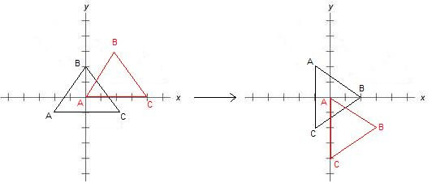
Introduction: 3D Coordinates
Every geometry, can be a triangle or a object composed from multiple triangles has a pivot.
The pivot is the point around which the triangle will rotate
Object space the pivot is always in (0,0,0)
90⁰ degrees rotation around the pivot.
The black triangle has his pivot in the centroid
The red triangle has his pivot in the point A.

Slide 8
Introduction: Vertex, Edge
Vertex
A vertex is a point in 3D space
Contains:
Position: x, y, z
Normal (later)
Color
Texture coordinates
Transferring data from RAM → GPU is expensive. So keep the vertex size minimum
Edge
The line is created by 2 vertices

Slide 9
Introduction: Face
Triangle
The intersection of the 3 edges defined by 3 vertices
Basically define a triangle in 3D
Polygon/Quad
4 vertex = 5 edges
2 faces/triangles

Slide 10
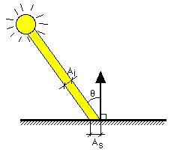
Introduction: Normal
Are vectors perpendicular to a face
See the picture 2:
Question:
Which case of lighting ray the eyes can see the illumination strongest?
Picture 1
Picture 2

Slide 11
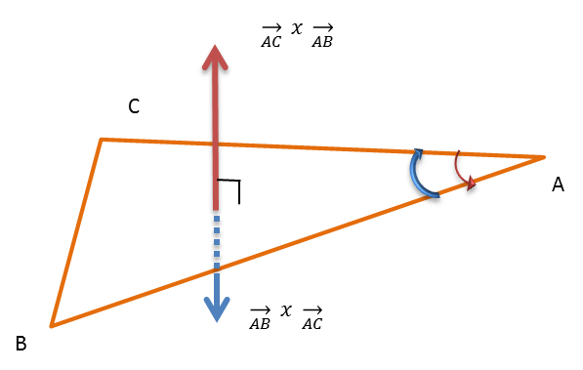

Introduction: Triangle points order
The order of triangle points determine the direction of triangle normal.
Triangle normal = cross product ($\overset{→}{AC},\overset{→}{AB})$
ACB = CBA = BAC = $\overset{→}{AC} x \overset{→}{AB}$ = $\overset{→}{red}$
ABC = $\overset{→}{AB} x \overset{→}{AC}$ = $\overset{→}{blue}$

Slide 12
Introduction: Pixel, Texel
Pixel
Pixel is a point on the screen
Is obtained through the combination of the three color channels, Red, Green and Blue
Texel
Textures are represented by arrays of Texel, just as pictures are represented by arrays of pixels.
A Texel is the pixel in a texture

Slide 13
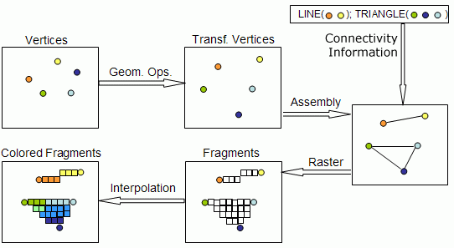
Introduction: Fragment
Fragments are an intermediate between vertices and pixels.

Slide 14
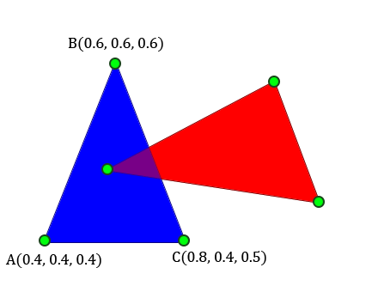
Pixel, Texel and Fragment
The difference between vertices, fragments and pixels are illustrated in beside Image, where:
The vertices are represented by green dots;
The fragments are blue or red; and
The pixels are blue, red or purple.

Slide 15
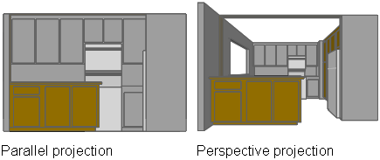
Introduction: Projection: Parallel & Perspective
Represents the way a 3D space (3D world) is projected onto a 2D space (the screen)
Parallel
Infinity eyes position
Projection lines (arrays) are parallel
Ortho is specific case of parallel projection when the ray is perpendicular to the projection plane
Perspective
Smaller as their distance from the observer increases
Do not preserve the distance and size ratio

Slide 16
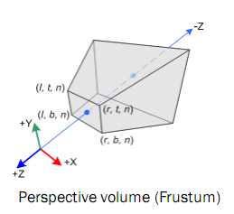
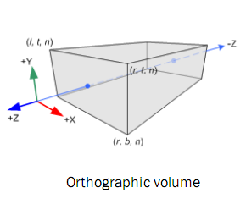
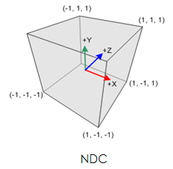
Introduction: Projection: Volume
Limitted region for 3D rendering on device
Left, right, top, bottom, near, far

Slide 17
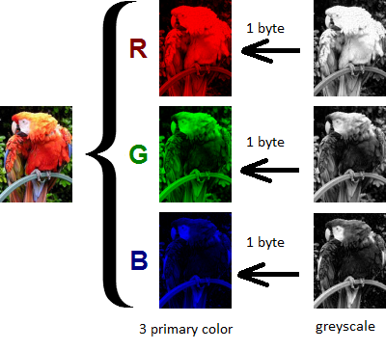
Introduction: Color channel
Each pixel is made of combinations of primary color called Color Channel included: Red, Green, Blue, Alpha (RGBA) (A is optional)
Each color channel stores color information valued 1byte [0, 255]
Color value in GLSL ranging from [0.0, 1.0]
More higher value of A channel, pixel is more opaque

Slide 18
Content
Introduction
Rendering pipeline
Shader
Basic GLSL-ES
Basic Math
MVP matrices
Textures
Model
Shader effect: Skydome using cube mapping

Slide 19
Rendering pipeline
Index stream
Transformations
Vertex stream
Attributes
Vertex shader
Varying
Primitive Assembly
Clipping
Backface Culling
Rasterization
Interpolation
Early Depth Test
Uniforms
Uniforms
Varying
Uniforms
Textures
Lights
World, View, Projection matrix
Others non-varying values
Fragment Shader
Color buffer
Depth test
Alpha test
Stencil test
Scissor test
Stencial buffer
Screen
Blending
Z - buffer

Slide 20
Rendering Pipeline: Vertex Stream
Index stream
Transformations
Vertex stream
Attributes
Vertex shader
Varying
Primitive Assembly
Clipping
Backface Culling
Rasterization
Interpolation
Early Depth Test
Uniforms
Uniforms
Textures
Lights
World, View, Projection matrix
Others non-varying values
Uniforms
Varying
Color buffer
Fragment Shader
Stencial buffer
Z - buffer
Screen
Blending
Depth test
Alpha test
Stencil test
Scissor test
Array of vertices sent from the RAM to the GPU memory
Every vertex value is viewed as a attribute
position
Normal
UV
Color
of a vertex are all attributes

Slide 21
Rendering Pipeline: Vertex Shader
Index stream
Transformations
Vertex stream
Attributes
Vertex shader
Varying
Primitive Assembly
Clipping
Backface Culling
Rasterization
Interpolation
Early Depth Test
Uniforms
Uniforms
Textures
Lights
World, View, Projection matrix
Others non-varying values
Uniforms
Varying
Color buffer
Fragment Shader
Stencial buffer
Z - buffer
Screen
Blending
Depth test
Alpha test
Stencil test
Scissor test
Allow programmers define certain transformation on every vertex which enters the pipeline.
Uniform: values that remain unchanged throughout the steps of the pipeline
Ex: Object's world, view and projection matrix
Vertex Shader take in Uniform + attributes then pass out varying values for Fragment Shader

Slide 22
Rendering Pipeline: Index Stream and Primitive Assembly
Index stream
Transformations
Vertex stream
Attributes
Vertex shader
Varying
Primitive Assembly
Clipping
Backface Culling
Rasterization
Interpolation
Early Depth Test
Uniforms
Uniforms
Textures
Lights
World, View, Projection matrix
Others non-varying values
Uniforms
Varying
Color buffer
Fragment Shader
Stencial buffer
Depth test
Alpha test
Stencil test
Scissor test
Z - buffer
Screen
Blending
Every object is broken down into basic geometry elements called primitive:
TRIANGLE
TRIANGLE_STRIP
QUAD
QUAD_STRIP
LINE,…
The common use are the TRIANGLE and TRIANGLE_STRIP
Primitive
Index stream
Clipping
Backface Culling

Slide 23
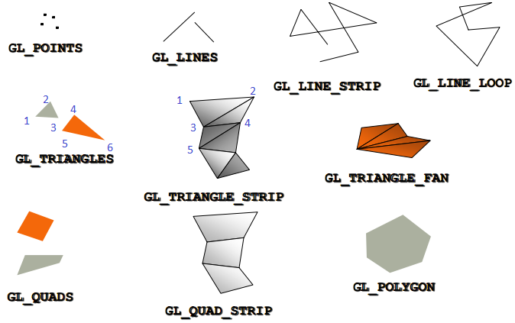
Rendering Pipeline: Index Stream and Primitive Assembly
Primitive
Index stream
Clipping
Backface Culling
6 vertices needed for 2 triangles
4 vertices needed for 2 triangles
What is index stream?
To reduce traffic between RAM and GPU memory, using glDrawElements() instead of glDrawArray()
Notes:
The differences between drawElement() and glDrawArray(), explan details.

Slide 24
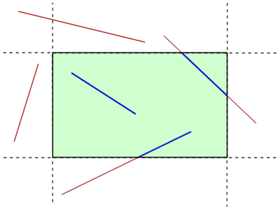
Rendering Pipeline: Index Stream and Primitive Assembly
Passes all the primitives that are entirely inside the view volume
Removes all primitives that are entirely outside the view volume
Primitives that are partially inside the view volume require clipping: replaced by a new vertex located at the intersection (blue lines)
Primitive
Index stream
Clipping
Backface Culling

Slide 25
Rendering Pipeline: Index Stream and Primitive Assembly
Primitive
Index stream
Clipping
Backface Culling
The backface culling (if is enabled):
It removes all primitives whose normals make an obtuse angle with the view vector.
Number of fragments generated are greatly reduced → improving performance.

Slide 26
Rendering Pipeline: Rasterization and Interpolation
Index stream
Transformations
Vertex stream
Attributes
Vertex shader
Varying
Primitive Assembly
Clipping
Backface Culling
Rasterization
Interpolation
Early Depth Test
Uniforms
Uniforms
Textures
Lights
World, View, Projection matrix
Others non-varying values
Uniforms
Varying
Color buffer
Fragment Shader
Stencial buffer
Depth test
Alpha test
Stencil test
Scissor test
Z - buffer
Screen
Blending
The rasterization
The rasterization is the process in which the GPU determines the pixels covered by the primitive. The primitive can be filled or not!
The interpolation
Takes place on all values coming from the vertex shader.
Converts primitives into a set of two-dimensional fragments, which are processed by the fragment shader

Slide 27
Rendering Pipeline: Rasterization and Interpolation (conts)
The interpolation (conts)
Calculate the varying of each fragment → shouldn't use too many varying for optimization
Discard automatically unused variables
Unused attribute will be passed with a default value (if don't enable the vertex attribute array)
Unused uniform won't be assigned an location (equals to -1).
Unused varying will not be computed / removed (depend on the implement of GPU)

Slide 28
Rendering Pipeline: Early Depth Test vs Depth Test
Index stream
Transformations
Vertex stream
Attributes
Vertex shader
Varying
Primitive Assembly
Clipping
Backface Culling
Rasterization
Interpolation
Early Depth Test
Uniforms
Uniforms
Textures
Lights
World, View, Projection matrix
Others non-varying values
Uniforms
Varying
Color buffer
Fragment Shader
Stencial buffer
Depth test
Alpha test
Stencil test
Scissor test
Z - buffer
Screen
Blending
Narrows down the number of fragments generated
Dropping fragments which are drawn behind previously drawn fragment
Referred as Z culling
In Pipeline only Early Depth Test or Depth Test will be processed
Early Depth Test only processes in some GPU as Adreno, Mali

Slide 29
Rendering Pipeline: Fragment Shader
Index stream
Transformations
Vertex stream
Attributes
Vertex shader
Varying
Primitive Assembly
Clipping
Backface Culling
Rasterization
Interpolation
Early Depth Test
Uniforms
Uniforms
Textures
Lights
World, View, Projection matrix
Others non-varying values
Uniforms
Varying
Color buffer
Fragment Shader
Stencial buffer
Depth test
Alpha test
Stencil test
Scissor test
Z - buffer
Screen
Blending
Allows the programmer to manipulate the color of fragments
Out put is the color of the fragment.
Make the alpha of all fragments oscillate between 0 and 1

Slide 30
Rendering Pipeline
Index stream
Transformations
Vertex stream
Attributes
Vertex shader
Varying
Primitive Assembly
Clipping
Backface Culling
Rasterization
Interpolation
Early Depth Test
Uniforms
Uniforms
Textures
Lights
World, View, Projection matrix
Others non-varying values
Uniforms
Varying
Color buffer
Fragment Shader
Stencial buffer
Depth test
Alpha test
Stencil test
Scissor test
Z - buffer
Screen
Blending
Before go in Testing steps, you have to know about buffer which testing steps are done on it.
Color Buffer
Z buffer
Depth Test
Stencil Buffer
Stencil Test
Scissor Test
Alpha Test

Slide 31
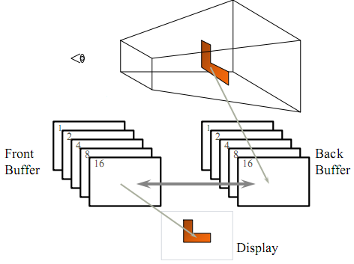
Rendering Pipeline: Rendering buffers
The color buffer (pixel buffer)
Content value of color for each pixel
Divide into two half (double buffer)
Front buffer
Back buffer
Clear current color buffer glClear(GL_COLOR_BUFFER_BIT)

Slide 32
Rendering Pipeline: Rendering buffers
The stencil buffer
An extra buffer at the programmer's disposal , and it stores an integer value for each pixel on the screen.
Size: sizeof(int) * screen_width * screen_height.

Slide 33
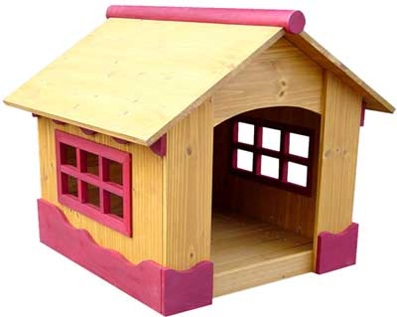







Rendering Pipeline: Rendering buffers
The Z buffer (depth buffer)
Contains per-pixel floating-point data for the z depth of each pixel rendered
Keeps only the z value of pixel which is closest to the camera
Ranging of depth per pixel is [0.0, 1.0] (near plane is 0.0 and far plane is 1.0)
Vary size value from 8 → 32 bit
How buffer works?
0.6 0.5 0.2
0.2 0.5 0.2

Slide 34
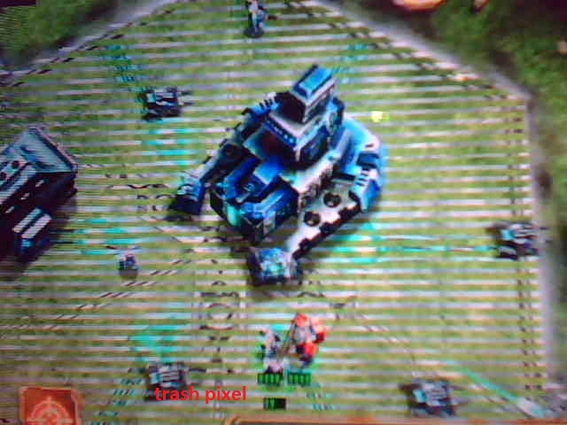
Rendering Pipeline: Rendering buffers
The Z fighting
A phenomenon that occurs when two or more primitives have similar values in the z-buffer
Higher value less chance to experience Z Fighting (16 bit is not as precise as 24 or 32 bit)
How to remove z-fighting?
Use of a higher resolution depth buffer
Moving the polygons further apart
Reduce far plane
Notes:
Please speak about Depth buffer non-liniarity (this comes from the division Z_clip/W_clip). Also speak about the precision of the depth buffer = near plane / far plane. This is why increasing the near plane or decreasing the far plane increases precision.

Slide 35
Rendering Pipeline: Testing steps
Index stream
Transformations
Vertex stream
Attributes
Vertex shader
Varying
Primitive Assembly
Clipping
Backface Culling
Rasterization
Interpolation
Early Depth Test
Uniforms
Uniforms
Textures
Lights
World, View, Projection matrix
Others non-varying values
Uniforms
Varying
Color buffer
Fragment Shader
Stencial buffer
Depth test
Alpha test
Stencil test
Scissor test
Z - buffer
Screen
Blending
Depth Test:
Test every fragment's z with the current z buffer
glEnable(GL_DEPTH_TEST)
Alpha fragments won’t be written z-values to depth buffer ?
Solid nodes → front to back ?
Transparent nodes → back to front?
Transparent nodes must be renders at the end after others nodes.
Use glDepthMask(GL_FALSE)to disable writing to Z-buffer
Minimizing the amount of overdraw

Slide 36
Rendering Pipeline: Testing steps
Alpha Test:
Test each fragment's alpha channel with a value
Drop fragments which don’t meet the alpha requirements
Objects that make use of alpha test will be treated as opaque objects
The fragments that failed the alpha test won't update the Z Buffer

Slide 37
Rendering Pipeline: Testing steps
Stencil Test
Test each fragment’s coordinates with the stencil buffer
The stencil test + depth test → creating shadows, outlines and other graphical effects.
Besides, Stencil Test can be used to implement selection
glEnable(STENCIL_TEST)
Scissor Test
Basically restricts the drawing area, creating viewports or rendering specific area
The order in which the tests are performed:
Scissors Test → Alpha Test → Stencil Test → Depth Test
glEnable(SCISSOR_TEST)

Slide 38
Rendering Pipeline: Blending step
Index stream
Transformations
Vertex stream
Attributes
Vertex shader
Varying
Primitive Assembly
Clipping
Backface Culling
Rasterization
Interpolation
Early Depth Test
Uniforms
Uniforms
Textures
Lights
World, View, Projection matrix
Others non-varying values
Uniforms
Varying
Color buffer
Fragment Shader
Stencial buffer
Depth test
Alpha test
Stencil test
Scissor test
Z - buffer
Screen
Blending
Transparency effect is generated
Computing the final color of the fragment
After the blend step, the fragment becomes a pixel and it's color value is stored in the color buffer

Slide 39
Content
Introduction
Rendering pipeline
Shader
Basic GLSL-ES
Basic Math
MVP matrices
Textures
Model
Shader effect: Skydome using cube mapping

Slide 40
Shader
Shader defines certain behavior for all vertices and fragments that come into the rendering pipeline
Two types
Vertex shader
Fragment shader
Following steps must be done before shaders can be used:
Compile shaders
Attach shaders to program
Link program
Use program to send necessary information to GPU

Slide 41
Shader
These are build-in variables
Uniforms
Textures
Varying 0
Varying 1
Varying 2
Varying 3
Varying 6
Varying 4
Varying 5
Varying 7
Attribute 0
Attribute 1
Attribute 2
Attribute 3
Attribute 6
Attribute 4
Attribute 5
Attribute 7
Vertex Shader
Varying 0
Varying 1
Varying 2
Varying 3
Varying 6
Varying 4
Varying 5
Varying 7
Uniforms
Textures
gl_Position
Fragment Shader
gl_FragColor
gl_FrontFacing
gl_FragCoord
gl_PointCoord

Slide 42
Shade calling structure
Shader source
Vertex Shader
Fragment Shader
GLUseProgram(Gluint
Program)
DrawObject()
Load and Compile Vertex Shader
Load and Compile Fragment Shader
Compile & Linking
Program
C++ source
(Gluint) Program

Slide 43
Shader
These variables are never used
When shaders are compiled, the varying, attributes, uniforms or any other unused local variable will be removed
Pseudo:
Vertex shader | Fragment shader
uniform mat4 u_mvpMatrix; attribute vec3 a_position; attribute vec4 a_color; varying vec4 v_color; void main() { //gl_Position must be set on //every vertex shader gl_Position = vec4(a_position, 1.0); v_color = a_color; } | precision lowp float; varying vec4 v_color; void main() { //gl_FragColor must be set on //every vertex shader //gl_FragColor = v_color ; gl_FragColor = vec4(1.0, 0.0, 0.0, 1.0); }
Why need precision?

Slide 44
Shader
Pseudo: LoadShader
GLuint LoadShader (Glenum type, const char* shadersrc) { GLint compiled; // create a shader and get his handle. // The type can be either GL_VERTEX_SHADER or GL_FRAGMENT_SHADER GLuint aShader = glCreateShader (type); // send the shader source code to be compiled - shadersrc is of type char* glShaderSource(aShader, 1 , &shadersrc,NULL); // compile the shader glCompileShader(aShader); //check if the compilation of the shader succeeded glGetShaderiv(aShader,GL_COMPILE_STATUS,&compiled); //if compilation has failed delete the shader and return a null handle if (!compiled) { glDeleteShader(aShader); return 0; } return aShader; }

Slide 45
Shader
Pseudo: LoadShader debug log
//debug by out put the info glGetShaderiv ( shader, GL_INFO_LOG_LENGTH, &infoLen ); if ( infoLen > 1 ) { char* infoLog = (char *)malloc (sizeof(char) * infoLen ); glGetShaderInfoLog ( shader, infoLen, NULL, infoLog ); esLogMessage ( "Error compiling shader:\n%s\n", infoLog ); free ( infoLog ); }

Slide 46
Shader
Need a program to know what shaders to use
A program is composed from a vertex shader and a fragment shader
Pseudo: Create Program
GLuint CreateProgram (const char* VertexShaderSrc, const char* FragmentShaderSrc) { GLuint vertexShader; GLuint fragmentShader; GLuint programHandle; Glint linked; //load and compile the vertex shader vertexShader=LoadShader(GL_VERTEX_SHADER,VertexShaderSrc); //load and compile the fragment shader fragmentShader=LoadShader(GL_FRAGMENT_SHADER,FragmentShaderSrc); //create a program and get it's handle programHandle=glCreateProgram();

Slide 47
Shader
Pseudo: Create Program
//attach the shaders to the program glAttachShader(programHandle,vertexShader); glAttachShader(programHandle,fragmentShader); //link the program glLinkProgram(programHandle); //check if linking was successful glGetProgramiv(programHandle,GL_LINK_STATUS,&linked); //delete the program if the link was not successful and return an invalid handle if (!linked) { glDeleteProgram(programHandle); return 0; } return programHandle; }

Slide 48
Shader
The only data we can send to the GPU RAM are attributes and uniforms.
Varying values are passed from the vertex shader to the fragment shader
Finding the location of the attributes and uniforms we want to send to the GPU by
glGetAttribLocation
glGetUniformLocation
Make sure that these calls are AFTER the program has been successfully linked.

Slide 49
Shader
For our two shaders we will have the following code:
Use glVertexAttribPointer for each data sent to GPU
Use glUniformMatrix4fv to send uniform matrix to GPU
Notice: glGetAttribLocation will return -1 for a_color because after the compile it has been removed.
GLint position = glGetAttribLocation(programHandle,"a_position"); GLint color = glGetAttribLocation(programHandle,"a_color");// this return -1
if (position != -1) glVertexAttribPointer(position, 3, GL_FLOAT,GL_FALSE,0,&vertices_positions); if (color != -1) glVertexAttribPointer(color, 4, GL_FLOAT,GL_FALSE,0, &vertices_color);

Slide 50
Shader: Draw TRIANGLE
Must call to attributes will actually get to the GPU
NON VBO: float verticesArray[9] = {}; float colorArray[12] = {}; glVertexAttribPointer(position, 3, GL_FLOAT, 0, verticesArray); glEnableVertexAttribArray(position); glVertexAttribPointer(color, 4, GL_FLOAT, 0, colorArray); glEnableVertexAttribArray(color); glDrawArrays(GL_TRIANGLES, 0, 3);
What happens without this method?

Slide 51
Shader
void glVertexAttribPointer(
GLuint index,
GLint size,
GLenum type,
GLboolean normalized,
GLsizei stride,
const GLvoid * pointer);
To pass all properties of each vertex of model to OpenGL method's parameters.
Position inside the shader of the attribute
Size of the attribute
Type of the attribute
The stride
For non-interleaved vertex data, it’s 0
For interleaved data, it’s the offset in the vector between the data for interleaved data
A pointer to the buffer that holds the values
Notes:
Explain here about Indexed vertices + Interleaved vs. Non-Indexed.
Details in: https://wiki-sai.gameloft.org/index.php/Android_HD%2B_Interleaved_vertex_data_problem

Slide 52
Non-Interleaved and Interleaved data
A vertex has 4 basic properties:
Position (x, y, z) or (x, y, z, w)
Color (r, g, b) or (a, r, g, b)
Texture coordinate (s, t) aka (u, v)
Normal vector (x, y, z)
Basically, we can store Position, Color, Texcoord and Normal in independent arrays.
This is non-interleaved data.
pVertex = { 0, 1, 1, //position of vertex 0 2, 4, 2, //position of vertex 1 1, 4, 6, //position of vertex 2 5, 1, 5 //position of vertex 3 } | pTexCor = { 0.1, 0.1, //tex-coord of vertex 0 0.2, 0.5, //tex-coord of vertex 1 0.1, 0.7, //tex-coord of vertex 2 0.9, 0.1 //tex-coord of vertex 3 }

Slide 53
Non-Interleaved and Interleaved data
Otherwise, Interleaved data, we could you only one array, stored in a structure
struct Vertex
{
float x,y,z; //pos // Vector3 pos
float u,v; //texcoord // Vector2 uv
float r,g,b,a; //color // Vector4 color
float x, y, z; //normal // Vector3 normal
}
Now calculate stride:
Position: include 3 float numbers (x, y, z) take 3*sizeof(float) = 12 bytes
Texcoord: include 2 float numbers (u, v) take 2*sizeof(float) = 8 bytes
Color: include 4 float numbers (r, g, b, a) take 4*sizeof(float) = 16 bytes
Normal: include 3 float numbers (x, y, z) take 3*sizeof(float) = 12 bytes
So, stride is equal to 12 + 8 + 16 + 12 == 48 or sizeof(Vertex)

Slide 54
Non-Interleaved and Interleaved data
When passing all properties of each vertex of model to OpenGL method's parameters by glVertexAttribPointer, you need to find the pointer pointed to exact location of a stride:
glVertexAttribPointer(index, size, type, normalized, stride, const GLvoid * pointer);
Pos: glVertexAttribPointer(posLocation, size, type, normalized, stride, 0);
UV: glVertexAttribPointer(UVLocation, size, type, normalized, stride, (char*) 0 + sizeof(Vector3));
The same for Color: (char*) 0 + sizeof(Vector3) + sizeof(Vector2)
12 bytes
8 bytes
16 bytes
Pos: 0 |  |  | UV: 12 |  | Color: 20 |  |  |  | Normal: 32
4 bytes | 4 bytes | 4 bytes | 4 bytes | 4 bytes | 4 bytes | 4 bytes | 4 bytes | 4 bytes | 4 bytes | 4 bytes | 4 bytes

Slide 55
VBO: Vertex Buffer Object
The Vertex data is stored in System memory, each call to glDrawArray or glDrawElements is made, this data is copied to Graphic Memory.
To avoid copying data on every draw call, we will use VBO to cache the data in graphic memory to:
Improve the rendering performance
Additional reduce the memory bandwidth
Reduce power consumption requirements.
System Memory
Copying data for every draw call
Graphic Memory

Slide 56
VBO: Vertex Buffer Object
How to use VBO?
There are 2 kinds: GL_ARRAY_BUFFER for vertex array and GL_ELEMENT_ARRAY_BUFFER for indices array
Initialize Vertex buffer: glGenBuffers(1, &vboId); glBindBuffer(GL_ARRAY_BUFFER, vboId); glBufferData(GL_ARRAY_BUFFER, sizeof(verticesData), verticesData, GL_STATIC_DRAW); glBindBuffer(GL_ARRAY_BUFFER, 0);
Initialize Indices buffer: glGenBuffers(1, &iboId); glBindBuffer(GL_ELEMENT_ARRAY_BUFFER, iboId); glBufferData(GL_ELEMENT_ARRAY_BUFFER, sizeof(verticesData), verticesData, GL_STATIC_DRAW); glBindBuffer(GL_ELEMENT_ARRAY_BUFFER, 0);

Slide 57
VBO: Vertex Buffer Object
How to use VBO?
Drawing Vertex buffer & Element Buffer: glBindBuffer(GL_ARRAY_BUFFER, vboId); glEnableVertexAttribArray(myShaders.positionAttribute); glVertexAttribPointer(myShaders.positionAttribute, 3, GL_FLOAT, GL_FALSE, sizeof(Vertex), 0); glBindBuffer(GL_ELEMENT_ARRAY_BUFFER, iboID); glDrawElements(GL_TRIANGLES, 3, GL_UNSIGNED_INT, 0); //glDrawArrays(GL_TRIANGLES, 0, 3); glBindBuffer(GL_ARRAY_BUFFER, 0); glBindBuffer(GL_ELEMENT_ARRAY_BUFFER, 0);

Slide 58
Content
Introduction
Rendering pipeline
Shader
Basic GLSL-ES
Basic Math
MVP matrices
Textures
Model
Shader effect: Skydome using cube mapping

Slide 59
Basic GLSL
Introduction
GLSL declaration
References

Slide 60
Basic GLSL: Introduction
What Is GLSL? OpenGL Shading Language
C/C++ similar high level programming language for several parts of the graphic card
Can code (right up to) short programs, called shaders, which are executed on the GPU.
Why Shaders?
In OpenGLES 1.1, the graphic pipeline could only be configured, but not be programmed.
With Shaders you are able to program: your lighting mode, Shadows, Environment Mapping, Bump Mapping, Parallax Bump Mapping, HDR, and much more!

Slide 61
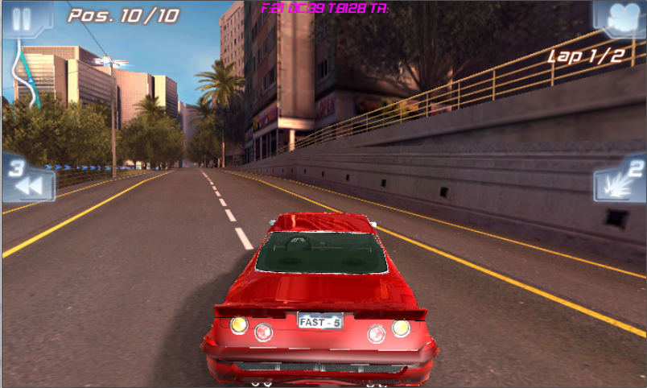
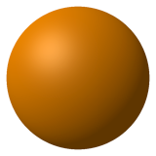
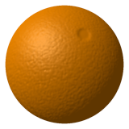
Basic GLSL: Introduction
Environment Mapping
Shadow
Bump Mapping

Slide 62
Basic GLSL: Introduction
You have nearly full control over what is happening with each vertex / fragment
Vertex shader | Fragment shader
Vertex Transformation Normal Transformation, Normalization and Rescaling Lighting Texture Coordinate Generation and Transformation And more. | Texture access and application (Texture environments) Fog Lightning And more

Slide 63
Basic GLSL: GLSL declaration
Data type
Vector constructor
Matrix constructor
Array constructor
Structure constructor
Vector component
Function definition

Slide 64
Basic GLSL: GLSL declaration
Data types
There are four main types: float, int, bool and sampler.
For the first three types, vector types are available:
vec2, vec3, vec4 2D, 3D and 4D floating point vector
ivec2, ivec3, ivec4 2D, 3D and 4D integer vector
bvec2, bvec3, bvec4 2D, 3D and 4D boolean vectors
For floats here are also matrix types:
mat2, mat3, mat4 2x2, 3x3, 4x4 floating point matrix
Some common errors (cause error without notices) :
float b = 3; // must be 3.0

Slide 65
Basic GLSL: GLSL declaration
Vector constructors
vec3(float) // initializes each component of with the float
vec2(float, float) // initializes a vec2 with 2 floats
ivec3(int, int, int) // initializes an ivec3 with 3 ints
vec3(vec4) // drops the fourth component of a vec4
vec3(vec2, float) // vec3.x = vec2.x, vec3.y = vec2.y, vec3.z = float
vec3(float, vec2) // vec3.x = float, vec3.y = vec2.x, vec3.z = vec2.y
vec4(vec2, vec2) // ???
Examples
vec4 color = vec4(0.0, 1.0, 0.0, 1.0); // 1.0 not 1.0f like C++
vec4 rgba = vec4(1.0); // sets each component to 1.0
vec3 rgb = vec3(color); // drop the 4th component

Slide 66
Basic GLSL: GLSL declaration
Matrix Constructors
To initialize the diagonal of a matrix with all other elements set to zero:
mat2(float), mat3(float), mat4(float)
To initialize a matrix by specifying vectors or scalars, the components are assigned to the matrix elements in column-major order:
mat2(vec2, vec2); // one column per argument
mat3(vec3, vec3, vec3); // one column per argument
mat4(vec4, vec4, vec4, vec4); // one column per argument
mat3x2(vec2, vec2, vec2); // one column per argument

Slide 67
Basic GLSL: GLSL declaration
mat2(float, float, // first column
float, float); // second column
mat3(float, float, float, // first column
float, float, float, // second column
float, float, float); // third column
mat4(float, float, float, float, // first column
float, float, float, float, // second column
float, float, float, float, // third column
float, float, float, float); // fourth column
mat2x3(vec2, float, // first column
vec2, float); // second column
mat2x3(mat4x2); // takes the upper-left 2x2 of the mat4x4, last row is 0,0
mat4x4(mat3x3); // puts the mat3x3 in the upper-left, sets the lower right component to 1, and the rest to 0

Slide 68
Basic GLSL: GLSL declaration
Array Constructors
Array types can also be used as constructor names, which can then be used in expressions or initializers. For example:
const float c[3] = float[3](5.0, 7.2, 1.1); const float d[3] = float[](5.0, 7.2, 1.1); float g; ... float a[5] = float[5](g, 1, g, 2.3, g); float b[3]; b = float[3](g, g + 1.0, g + 2.0);

Slide 69
Basic GLSL: GLSL declaration
Structure Constructors
Once a structure is defined, and its type is given a name, a constructor is available with the same name to construct instances of that structure. For example:
struct light { float intensity; vec3 position; }; light lightVar = light(3.0, vec3(1.0, 2.0, 3.0));

Slide 70
Basic GLSL: GLSL declaration
Vector Components
The component names supported are:
{x, y, z, w} Useful when accessing vectors that represent points or normals
{r, g, b, a} Useful when accessing vectors that represent colors
{s, t, p, q} Useful when accessing vectors that represent texture coordinates
The component names x, r, and s are, for example, synonyms for the same (first) component in a vector.
Accessing components beyond vector type is error. For example:
vec2 pos;
pos.x // is legal
pos.z // is illegal

Slide 71
Basic GLSL: Data Types In GLSL
Vector component (conts)
The component selection syntax allows multiple components to be selected by appending their names
(from the same name set) after the period ( . ).
vec4 v4; v4.rgba; // is a vec4 and the same as just using v4, v4.rgb; // is a vec3, v4.b; // is a float, v4.xy; // is a vec2, v4.xgba; // is illegal - the component names do not come from the // same set.

Slide 72
Basic GLSL: GLSL declaration
Vector component (conts)
The order of the components can be different to swizzle them, or replicated:
vec4 pos = vec4(1.0, 2.0, 3.0, 4.0);
vec4 swiz= pos.wzyx; // swiz = (4.0, 3.0, 2.0, 1.0)
vec4 dup = pos.xxyy; // dup = (1.0, 1.0, 2.0, 2.0)
The component group notation can occur on the left hand side of an expression.
vec4 pos = vec4(1.0, 2.0, 3.0, 4.0);
pos.wx = vec2(7.0, 8.0); // pos = (8.0, 2.0, 3.0, 7.0)
pos.xx = vec2(3.0, 4.0); // illegal - 'x' used twice
pos.xy = vec3(1.0, 2.0, 3.0); // illegal - mismatch between vec2 and vec3
//pos[2] refers to the third element of pos and is equivalent to pos.z.

Slide 73
Basic GLSL: GLSL declaration
Function Definitions
A function is declared as the following example shows:
// prototype
returnType functionName (type0 arg0, type1 arg1, ..., typen argn);
And a function is defined like
// definition
returnType functionName (type0 arg0, type1 arg1, ..., typen argn)
{
// do some computation
return returnValue;
}

Slide 74
Basic GLSL: GLSL declaration
Function Definitions (conts): Basic built-in functions
float dot (genType x, genType y) //Returns the dot product of x and y vec3 cross (vec3 x, vec3 y) //Returns the cross product of x and y genType normalize (genType x) // Returns a vector in the same direction as x but with a length of 1 genType reflect (genType I, genType N)//For the incident vector I and surface //orientation N, returns the reflection //direction. N must already be normalized float length (genType x) //Returns the length of vector X genType mix (genType x,genType y,float a) //Returns the linear blend of x and y genType abs (genType x) //Returns x if x >= 0, otherwise it returns –x genType sqrt (genType x) //Returns square root of (x) genType pow (genType x, genType y)//Returns x raised to the y power genType sin (genType angle) //The standard trigonometric sine function

Slide 75
References
Docs:
Slide, demo and detail book about workshop content:
\\sai-data01\Documents\Specialized\Programming\Training\01. MegaTraining\Basic\3D & OpenGL\GLES 2.0 workshop
More about shader and opengles2.0:
\\sai-data01\Documents\Specialized\Programming\Training\01. MegaTraining\Basic\3D & OpenGL\OpenGL_ES
\\sai-data01\Documents\Specialized\Programming\Training\01. MegaTraining\Basic\3D & OpenGL\Shader
Kits:
\\sai-data01\Documents\Specialized\Programming\Training\01. MegaTraining\Basic\3D & OpenGL\Kits
To load .obj file: GLC_Player_1.5.0-setup.exe
To compile shader source: OGLES2_WINDOWS_PCEMULATION_2.04.24.0811.msi
Model and others:
\\sai-data01\Documents\Specialized\Programming\Training\01. MegaTraining\Basic\3D & OpenGL

